Slide 1

CAPSTONE PRESENTATION RETAIL DATA ANALYTICS
SHWETA GUPTA
PGPBABI

Slide 2
BACKGROUND

Slide 3
Business Problem Understanding
BACKGROUND
A leading Retail Chain would like to take better informed strategic decisions by predicting the department-wide sales for each store for the following year while analyzing the impact of markdowns on sales.
OBJECTIVES
Predict department-wide sales for each store for next year.
Model the effects of Markdowns on Sales during holiday weeks.
Provide recommended actions based on the insights drawn, with prioritization placed on largest business impact.
UNDERSTANDING BUSINESS/SOCIAL OPPORTUNITY
To boost consumer spends on retail, during holidays, using the right range of markdowns in the right departments
Prioritize the stores and departments with highest business impact

Slide 4
Data Report
421570 obs. of 17 variables:
$ Store : Factor w/ 45 levels "1","2","3","4"
$ Date : Date, format: "2011-04-01"
$ IsHoliday : logi FALSE FALSE FALSE
$ Dept : Factor w/ 81 levels "1","2","3","4",
$ Weekly_Sales: num 13168 5947 28545 9950 317
$ Type : Factor w/ 3 levels "A","B","C": 1 1 1 1
$ Size : int 151315 151315 151315 151315
$ Temperature : num 59.2 59.2 59.2 59.2 59.2 ...
$ Fuel_Price : num 3.52 3.52 3.52 3.52 3.52 ...
$ MarkDown1 : num NA NA NA NA NA NA NA
$ MarkDown2 : num NA NA NA NA NA NA NA
$ MarkDown3 : num NA NA NA NA NA NA NA
$ MarkDown4 : num NA NA NA NA NA NA NA
$ MarkDown5 : num NA NA NA NA NA NA NA
$ CPI : num 215 215 215 215 215 ...
$ Unemployment: num 7.68 7.68 7.68 7.68
$ weight : num 1 1 1 1 1 1 1 1 1 1 ...
High no of NAs are present in data
The NAs are present only in Markdown variables, due to the data on these variables not being collected in the initial time period
Data also seems to have outliers, especially in Markdown variables, Weekly_sales, Temperature and CPI variables
Total Missing Values: 1422431

Slide 5
EXPLORATORY DATA ANALYSIS

Slide 6
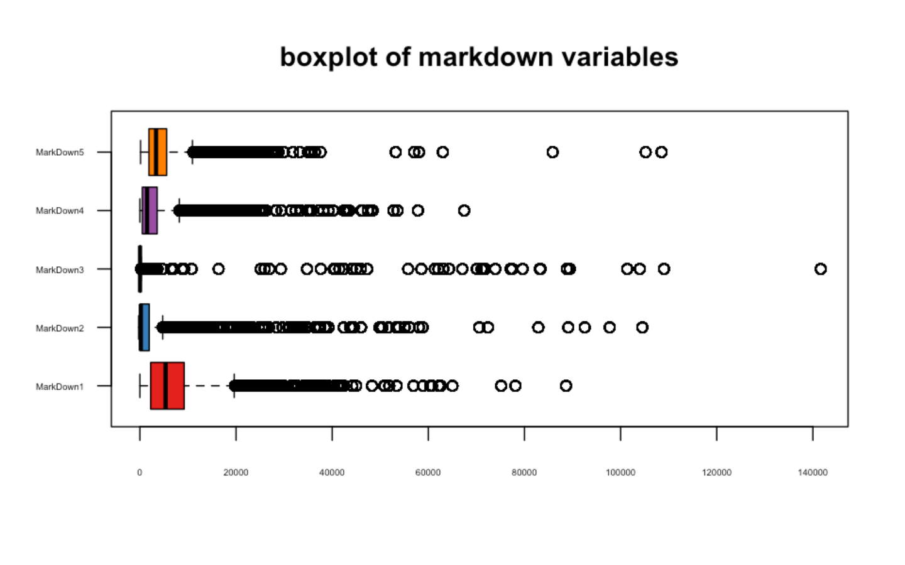
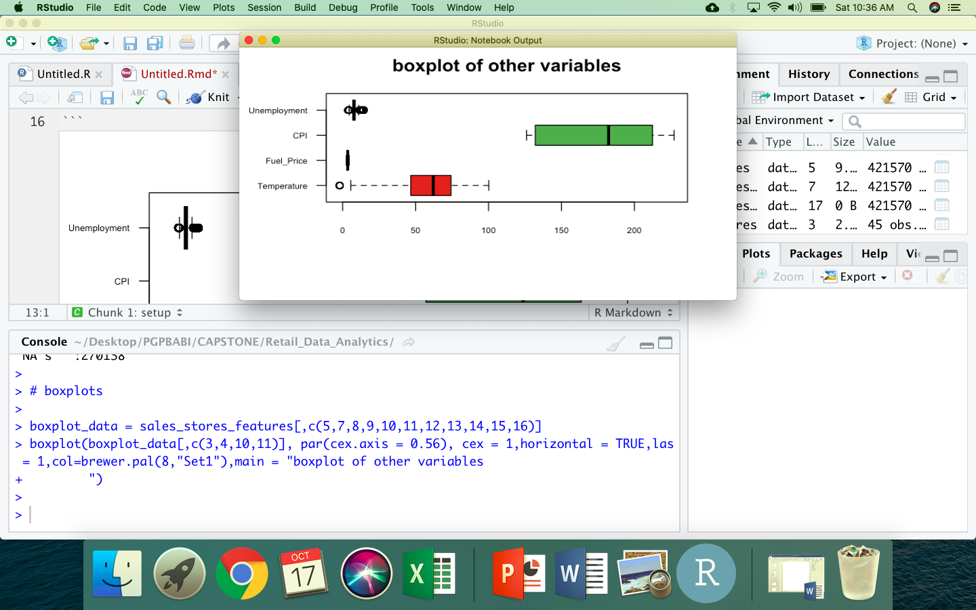
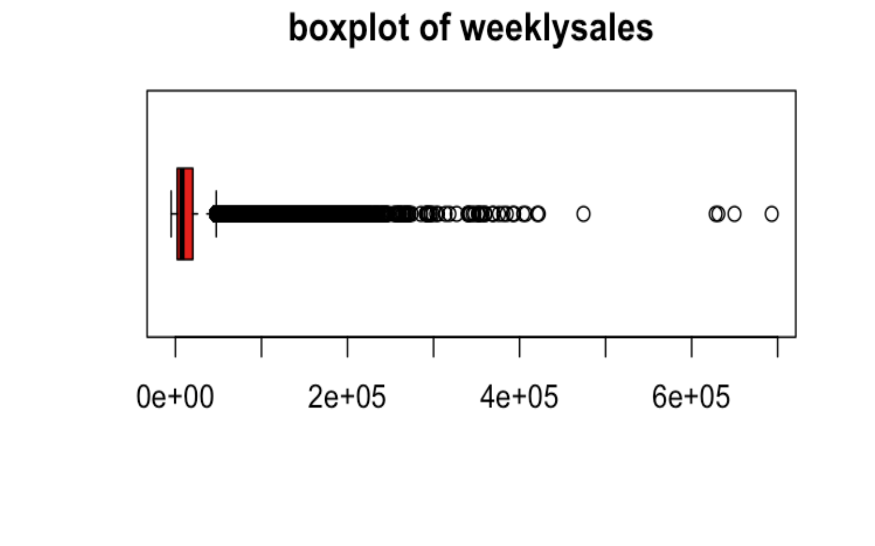
EDA- Boxplots
Markdown Variables
Other Variables
Weekly Sales
Markdown 1 has a higher range and average markdown compared to other markdowns
All Markdown variables have high number of outliers
Weekly Sales heavily impacted by outliers too
Among other variables, Unemployment and Temperature indicate presence of outliers

Slide 7
EDA- Correlations
Our numeric variables seem to have very weak correlations with weekly sales which is the variable of our interest
Also among independent variables or other variables, there is not much correlation present.
Hence, we can safely assume our dataset is free from multicollinearity
Temp
CPI
Fuel Price
Unemp
Markdn3
Weekly Sales
Markdn2
Size
Markdn6
Markdn1

Slide 8
EDA Summarise By Store Type And Isholiday
TABLE SUMMARY BY STORE TYPE
Type | sum_Weekly_Sales | avg_CPI | avg_unemployment | avg_ fuel price | size | avg_ temp | avg_markdown1 | avg_markdown2 | avg_markdown3 | avg_markdown4 | avg_markdown5
A | 4331014723 | 174.4 | 7.8 | 3.3 | 182231 | 60.5 | 8687 | 3764 | 1647 | 3916 | 6000
B | 2000700737 | 167.2 | 7.9 | 3.4 | 101819 | 57.6 | 7109 | 3064 | 1484 | 2926 | 3689
C | 405503528 | 170.4 | 8.9 | 3.4 | 40536 | 67.6 | 395 | 447 | 18 | 65 | 1384
Store Type A has highest sales, CPI and markdowns, followed by Store Type B
Overall average of all markdowns higher for when there is a holiday as compared to when it is not
Clearly as expected Markdowns are higher for top selling Stores and Departments
TABLE SUMMARY BY ISHOLIDAY
IsHoliday | sum_Weekly_ Sales | avg_CPI | avg_unemployment | avg_ fuel price | size | avg_ temp | avg_markdown1 | avg_markdown2 | avg_markdown3 | avg_markdown4 | avg_markdown5
FALSE | 6231919436 | 171 | 8.0 | 3.4 | 136718 | 61 | 7333 | 2299 | 196 | 3384 | 4723
TRUE | 505299552 | 171 | 8.0 | 3.2 | 136859 | 50 | 6241 | 13049 | 15078 | 3371 | 3537
TABLE SUMMARY BY TOP 3 SELLING STORES
Store | sum_Weekly_Sales | avg_CPI | avg_unemployment | avg_fuelprice | size | avg_temp | avg_markdown1 | avg_markdown2 | avg_markdown3 | avg_markdown4 | avg_markdown5
20 | 301397792 | 209 | 7.4 | 3.4 | 203742 | 55 | 11268 | 5818 | 2772 | 5438 | 6057
4 | 299543953 | 129 | 6.0 | 3.2 | 205863 | 62 | 9369 | 4575 | 1997 | 5243 | 6813
14 | 288999911 | 186 | 8.6 | 3.4 | 200898 | 58 | 11586 | 5441 | 2113 | 4226 | 5796

Slide 9
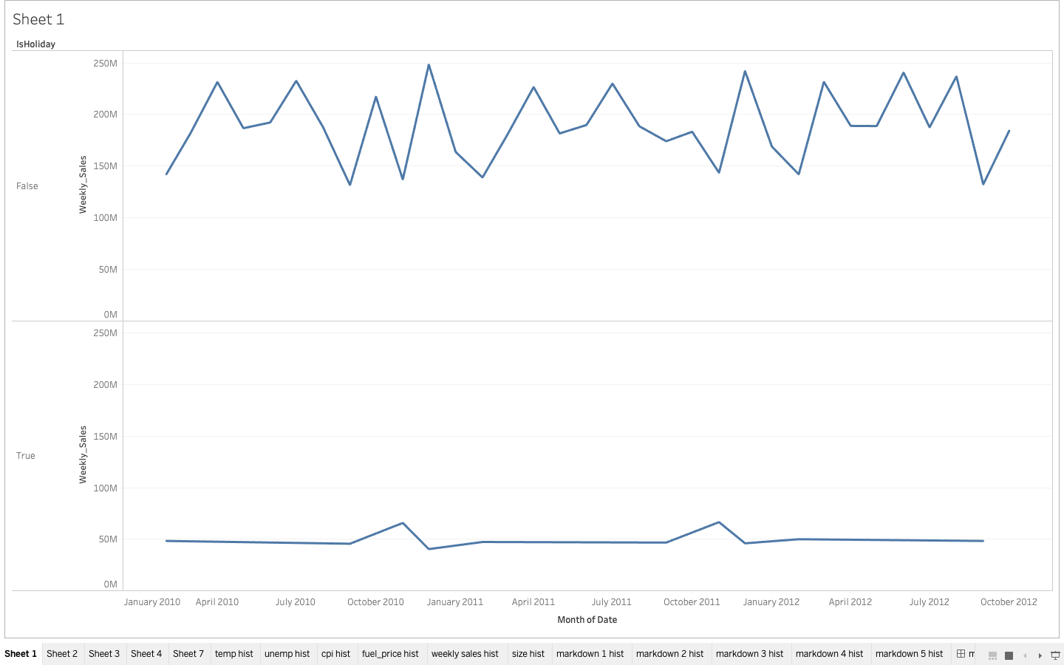
EDA - Weekly Sales By Isholiday
Overall weekly sales are witnessing a decline from 2010 to 2012
When there is a holiday weekly sales witness peaks in November every year
When it is not a holiday sales are peaking in April, July, October, December every year
ISHOLIDAY
FALSE
TRUE

Slide 10
MODELING APPROACH AND SUMMARY

Slide 11
Modelling Approach Used & Why
Data Treatment
Created two datasets - one with no missing values and one with imputed missing values
Treated outliers in the data using flooring and capping method.
Treated missing values in markdown variables, we replaced NAs with average markdown values
We then partitioned the data into Train and Test dataset in 70:30 ratio
Modeling
We need to predict Sales of stores, so our dependent variable is weekly sales which is a continuous variable. Also our predictor variables are a mix of continuous and factor variables
Hence we chose the below mentioned algorithms for modeling weekly sales which are suitable for this task
Linear Regression
Forward and Backward Regression
SVM
Random Forest
Decision Trees – Cart
XGboost
To arrive at the best fit model, we compared Rsqaure, RMSE and MSE across all the models, and the one with lowest RMSE is chosen as the final model

Slide 12
Linear Regression – Final Model Summary
COEFFICIENTS
Estimate Std. Error t value Pr(>|t|)
(Intercept) 2.836e+04 1.594e+04 1.778 0.075332 .
Temperature 1.194e+01 4.683e+00 2.551 0.010749 *
Fuel_Price -9.342e+02 2.224e+02 -4.201 2.66e-05 ***
MarkDown2 -6.920e-02 7.842e-03 -8.824 < 2e-16 ***
MarkDown3 2.028e+00 1.054e-01 19.251 < 2e-16 ***
CPI 2.877e+02 9.660e+01 2.978 0.002904 **
Unemployment 5.112e+02 2.024e+02 2.526 0.011536 *
Store2 3.465e+03 3.260e+02 10.628 < 2e-16 ***
Date -4.349e+00 1.150e+00 -3.781 0.000156 ***
IsHolidayTRUE 6.535e+02 1.345e+02 4.859 1.19e-06 ***
Dept2 2.706e+04 4.612e+02 58.668 < 2e-16 ***
R square - 74.8% of the variance found in response variable can be explained by the predictor variables
The Residual Standard Error indicates that actual weekly sales can deviate from the true regression line by approx 9750 on average.
The intercept indicates average weekly sales when we take average of all variables i.e. = 2.836e+04
The slope term for MarkDown3 means for every 1 unit increase in the MarkDown3 , weekly sales goes up by 2.028e+00
Since the P value is lower than 0.05 for all predictor variables , they are all significant in explaining response variable
Residual standard error: 9750 on 62668 degrees of freedom
Multiple R-squared: 0.7481, Adjusted R-squared: 0.7476
F-statistic: 1410 on 132 and 62668 DF, p-value: < 2.2e-16
HENCE, THE MODEL EQUATION
Weekly_sales = 2.836e+04 + (1.194e+01 )Temperature + (-9.342e+02)Fuel_price + (-6.920e-02)MarkDown2 + (2.028e+00)MarkDown 3 +
(2.877e+02)CPI + (5.112e+02)Unemployment +(3.465e+03)Store2+(-4.349e+00)Date+ (6.535e+02)IsHolidayTrue + (2.706e+04)Dept2

Slide 13
Random Forest Model – Importance Summary
%IncMSE IncNodePurity
Size 32312060.61 878781542313
Temperature 1317174.21 74339545383
Fuel_Price 1271922.63 70823129334
MarkDown1 1127615.25 81526669446
MarkDown2 699369.60 56222629123
MarkDown3 3772058.13 143219749978
MarkDown4 1454229.15 89553069246
MarkDown5 1311896.26 132809972816
CPI 12335881.93 253363721080
Unemployment 8651117.95 213581226906
Date 2016785.64 68809549150
IsHoliday 7427.93 3305156230
Type 15764058.37 323300799529
weight 1066.82 3211695310
Most important variables in the Random forest model are Type, CPI, Unemployment, Markdown5 ,Markdown 3 and Size

Slide 14
XGBoostModel – Importance Summary
Feature <chr> | Gain <dbl> | Cover <dbl> | Frequency <dbl>
Dept | 0.6809209965 | 0.406777020 | 0.099279866
Size | 0.1959863492 | 0.137973061 | 0.061928524
Store | 0.0522819935 | 0.066755535 | 0.029836252
CPI | 0.0299114259 | 0.103674450 | 0.177478635
Unemployment | 0.0132685388 | 0.045147081 | 0.069607960
Temperature | 0.0111260676 | 0.081617699 | 0.223629953
Fuel_Price | 0.0084154522 | 0.069744371 | 0.189087432
MarkDown3 | 0.0033681078 | 0.027961715 | 0.027938804
MarkDown2 | 0.0012791253 | 0.011674607 | 0.025891950
MarkDown4 | 0.0012567005 | 0.015887316 | 0.024308253
MarkDown1 | 0.0011613116 | 0.015524564 | 0.035379191
MarkDown5 | 0.0005834059 | 0.011056596 | 0.029567322
weight | 0.0004405253 | 0.006205984 | 0.006065858
Dept, Size and Store are the top 3 most important variables in our XGBoost model.

Slide 15
Summary Table – All Models
Model/Parameters | Rsquare | MSE | RMSE
Linear Regression_Full data Final Model
Train | 71.8% | 88652583 | 9415.55
Test | 71.7% | 558944750 | 23642.01
Linear Regression_NONA Data Final Model
Train | 74.7% | 94865383 | 9739.886
Test | 74.5% | 656198499 | 25616.37
SVM_NONA Data
Train | 77.9% | 86088185 | 9278.372
Test | 77.7% | 622794011 | 24955.84
Bagging_NONA Data
Train | 58.9% | 154567435 | 12432.52
Test | 58.9% | 151042425 | 12289.93
Decision Tree_Cart Full Data
Train | 97.2% | 8760126 | 2959.751
Test | 95.1% | 15475928 | 3933.946
Decision Tree_Cart NONA Data
Train | 96.7% | 12355648 | 3515.06
Test | 93.7% | 23171916 | 4813.722
XG Boost_Full Data
Train | 98.6% | 4517517 | 2125.445
Test | 95.1% | 15584339 | 3947.7
XG Boost_NONA Data
Train | 98.5% | 6002810 | 2450.063
Test | 93.4% | 24227700 | 4922.164
Random Forest_NONA Data
Train | 9% | 341074152 | 18468.19
Test | 7% | 341717875 | 18485.61
XG BOOST FULL DATA AND CART FULL DATA models have the best values on Rsquare and lowest values on MSE and RMSE.
MSE is a measure of how close a fitted line is to data points. The MSE has the units squared of whatever is plotted on the vertical axis.
RMSE - square root of the mean square error.

Slide 16
Recommendations
Weekly sales have a strong seasonal pattern where the sales peak during April, July, November and December every year.
As seen in the above table summary - XG BOOST FULL DATA AND CART FULL DATA models have the best values on Rsquare and lowest values on MSE and RMSE.
Since Cart models can overfit due to their design and complexity, we may choose to go ahead with XGboost model as our final model.
Sales can be predicted for the next year using our final shortlisted model. Then we can identify the highest selling/sensitive stores & departments for next year and prioritize them for taking marketing decisions
We can compare the sales of last 3 years versus the predicted sales for next year and identify if there are any stores or departments that are showing deviations( for example stores which are generating significantly lower sales compared to last year) and prioritize such stores/departments in our marketing actions
Also the impact of markdowns can be clearly understood using the linear regression model, and they can be finetuned basis the model equation coefficients for high selling or discount sensitive stores and departments

